Slide 1
Shipment Monitoring using IoT and Ethereum blockchain
ISE 639 – Advanced Independent Study
Nithish P. Saji

Slide 2
Index
Abstract
Software and Tools used
IoT Architecture
Hardware Setup
Real-time monitoring
Blockchain Implementation
Future Work
References
Source Code

Slide 3
Abstract
To demonstrate an IoT based system to monitor the attributes (ex: vibration) of a shipment using raspberry pi and analog sensors.
Shipment history verification using Ethereum blockchain deployed on rinkeby test network.

Slide 4
Software and Tools used
AWS IoT core
Solidity / Ethereum Remix
Metamask
Python
HTML ( for interface)
Truffle ( to test the smart contract )

Slide 5
IoT Architecture
Vibration information sent through MQTT
Continuous stream of data collected
Event triggered execution of transactions using smart contract
Cross-check and validation

Slide 6
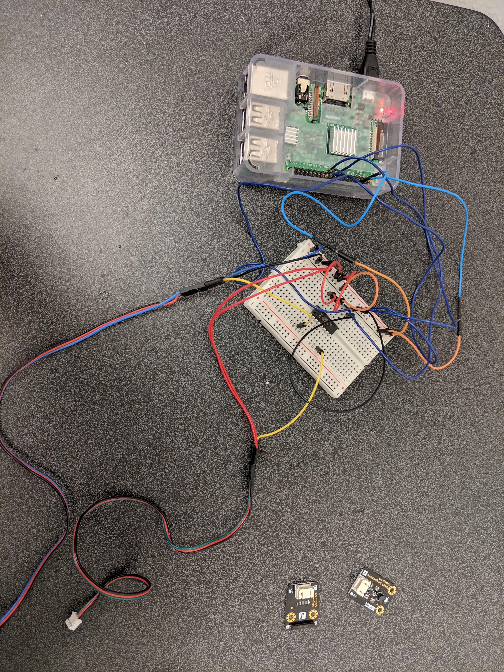
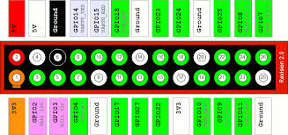
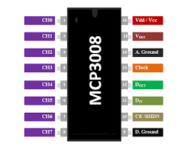
Hardware Setup
Raspberry Pi – Model B, MCP3008, 8 GB SD card, analog vibration sensor.
Since, raspberry pi doesn’t have any analog inputs, MCP3008 ADC was used to connect an analog sensor.
MCP3008 has 8 inputs. So 8 sensors can be connected at the same time.

Slide 7
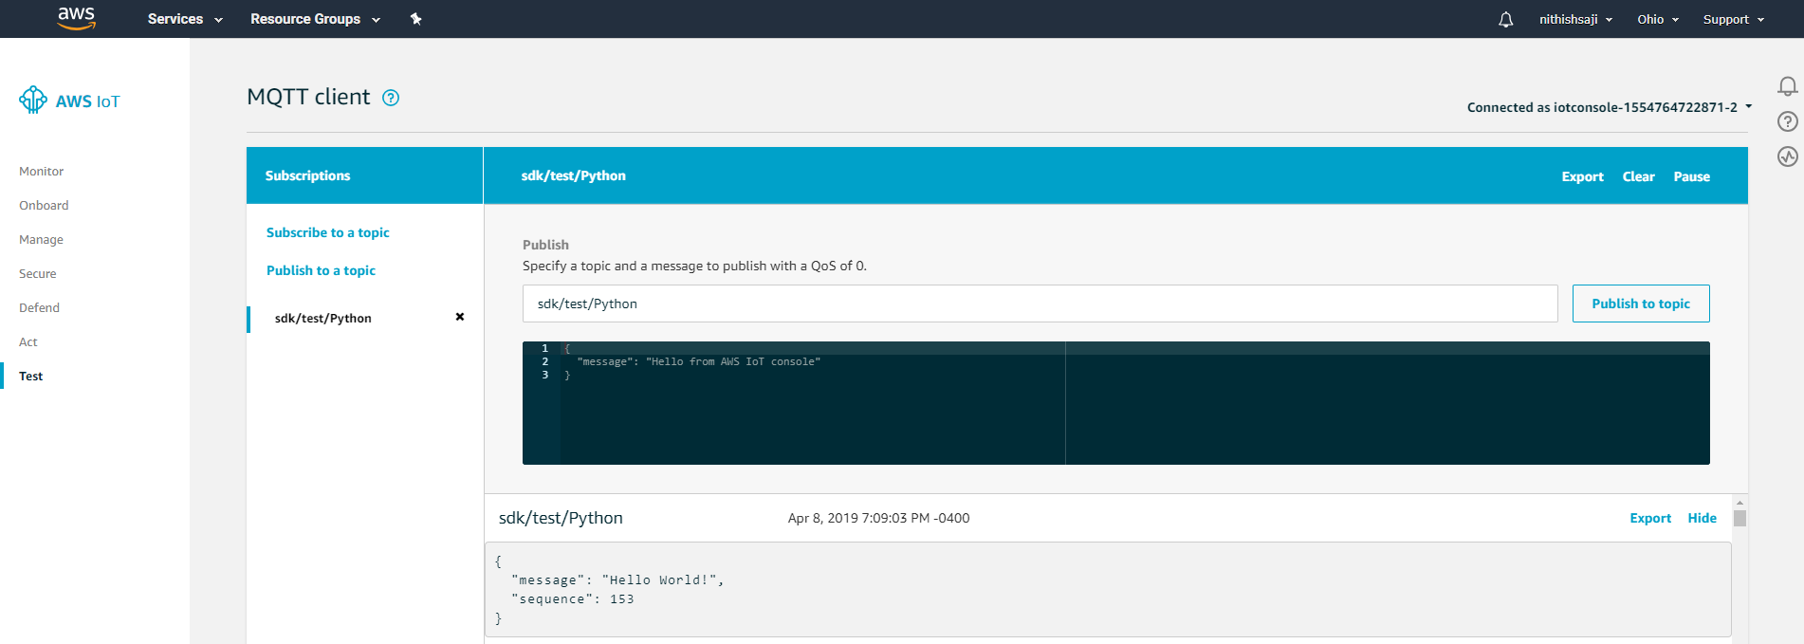
Real-time monitoring
AWS IoT core was used to continuously send the vibration data using the MQTT protocol.
AWS IoT dashboard can be used to view the stream and store the data.

Slide 8
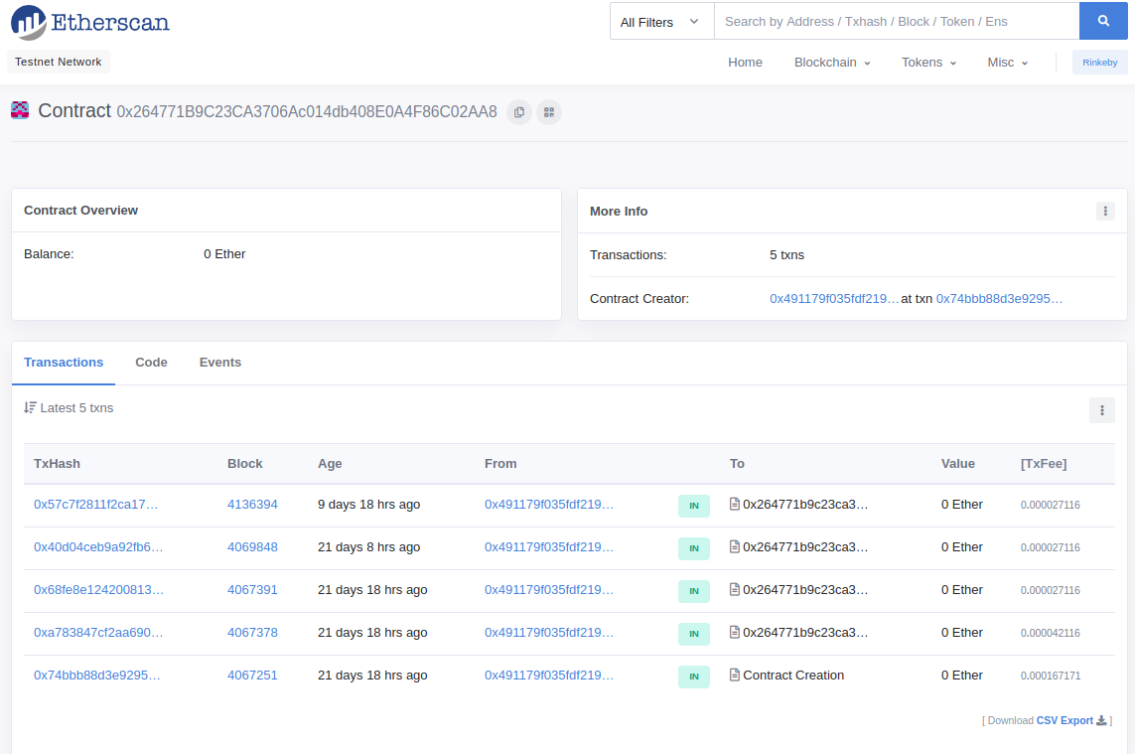
Blockchain Implementation
Smart contract was implemented to execute a transaction whenever the vibration of the shipment crossed predefined threshold.
The contract was deployed in rinkeby test network to demonstrate the use case.
Truffle was used to test the contract.

Slide 9
Future Work
Automate the transactions without metamask.
Extend smart contract functionality to incorporate events such as change of ownership, value addition etc.
Private blockchain implementation.

Slide 10
Reference
https://medium.com/@sajithswa/connect-your-raspberry-pi-with-aws-iot-28920dbc0e88
https://hackernoon.com/ethereum-smart-contracts-from-zero-to-end-to-end-dapp-ebae43cdf859
https://truffleframework.com/boxes
http://www.hertaville.com/interfacing-an-spi-adc-mcp3008-chip-to-the-raspberry-pi-using-c.html

Slide 11
Source Code
github.com/idukkigold/logistics_blockchain

